Slide 1
SE 361 Sprint #1 Review
Code Monkeys In Tech Support

Slide 2
Sprint Goals
Create a registration screen
Connect a database to the login/registration
Update login screen design
Create a welcome screen
Challenges for Sprint
Push/Pull is still not working as expected for some members - pull and push is not allowing members to so commit these actions without re-cloning repo.

Slide 3
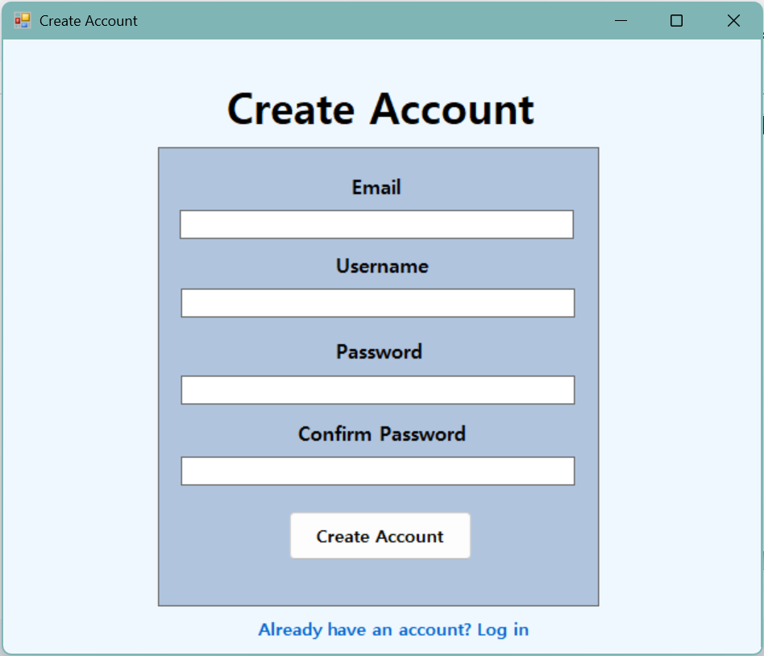
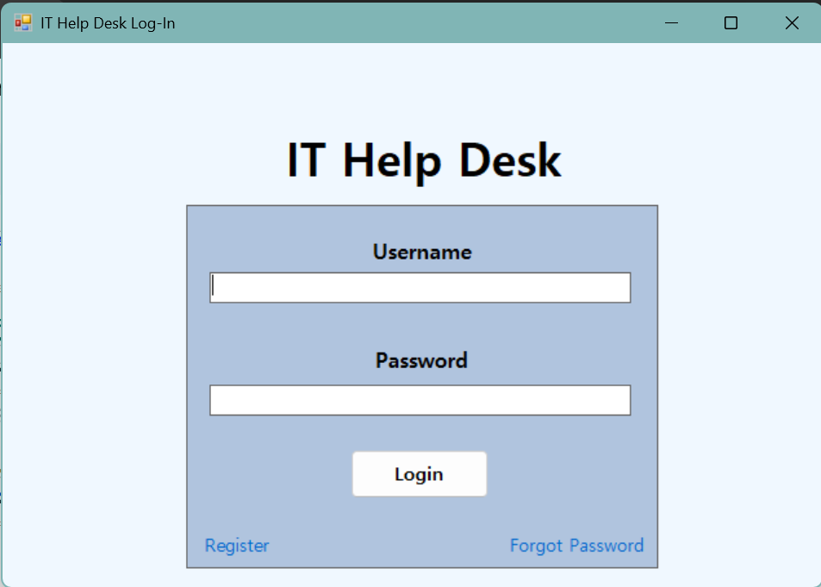
Current design
Updated color palette
Simple and Easier to look at
Registration screen
Simple design
Inspired by average login/registration screens

Slide 4
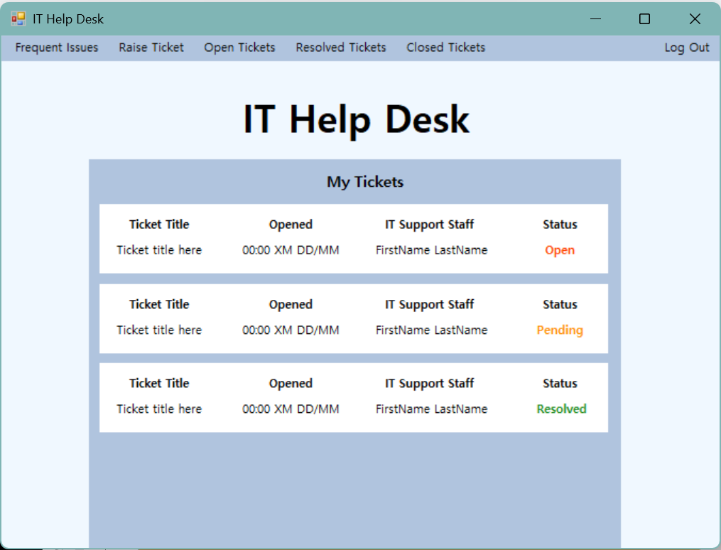
Current design
Ticket Title
Concise name that gives a general description of the problem
EX: Network Connection Failure
Opened
Gives the time and date of when tickets were placed
IT Support Staff
Allows user to see the name of the staff member in charge of the ticket
Status
Tells the user in what part of the process their ticket is in
Open - placed and awaiting progress
Pending - progress has been made but not yet completed
Resolved - issue has been taken care of ticket is completed
Tabs
Offers condensed views of particular information based on preference
Log Out
Takes you back to login screen

Slide 5
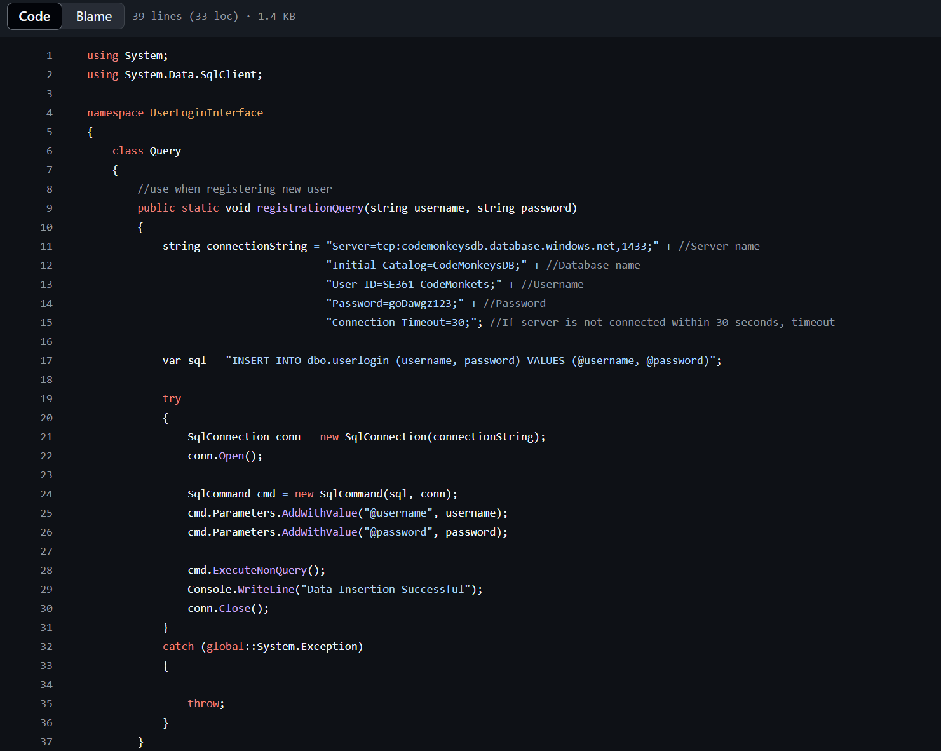

Slide 6

Current design implementation
Currently everything is working as expected with no issues. This trial takes us through three different screens and uses some of the features that are going to be offered on are project.

Slide 7
Future Goals
Main goal for next sprint will be to add functionality to the main screen
Ability to raise and interact with tickets
Update the Welcome and Login screen design
Implement a forgot password screen
Have the ability to connect to the username and update password in the database.
Implement incorrect password notification
Will let user know that given information is incorrect and to try again

